Slide 1
HTML / CSS Overview
Intro to HTML / CSS
Notes:
Hello everyone and welcome to this lesson, where we are going to do a quick overview of HTML and CSS

Slide 2
Front-end web development
HTML
Structure and content
CSS
Styling and layout
JavaScript
Dynamic interactivity
Notes:
The 3 core components of modern front end web development is HTML, CSS and JavaScript. HTML provides structure and content of the web page, while CSS adds on styling and layout so that the content is presented in a visually attractive manner. Finally, JavaScript allows the web page content to change dynamically in response to user interaction with it. For .e.g actions such as. the user moving the mouse over certain web content or clicking on specific elements on the page will cause certain elements to change in size, move, appear or disappear. Typically, you use JavaScript with HTML and CSS to enhance a web page’s functionality, such as validating forms, creating interactive maps, and displaying animated charts.

Slide 3
HyperText Markup Language
Uses markup tags to characterize text elements within a document
Hypertext contains references to other text accessible via the web
Building block of the WWW
Notes:
HTML stands for HyperText Markup Language. Hypertext is text displayed on any electronic device with references to other text that the user can immediately access, usually by a mouse click or key press. This access is via the World Wide Web, and HTML is a key building block of the web.
Markup languages use sets of markup tags to characterize text elements within a document. These markup tags gives instructions to the web browsers on how to render the document
Apart from text, hypertext may contain tables, lists, forms, images, and other presentational elements.

Slide 4
HTML functionality
publish documents online with text, images, lists, tables, etc.
access web resources such as images, videos or other HTML document via hyperlinks.
create forms to collect user data
include images, videos, sound clips, applications directly inside a HTML document

Slide 5
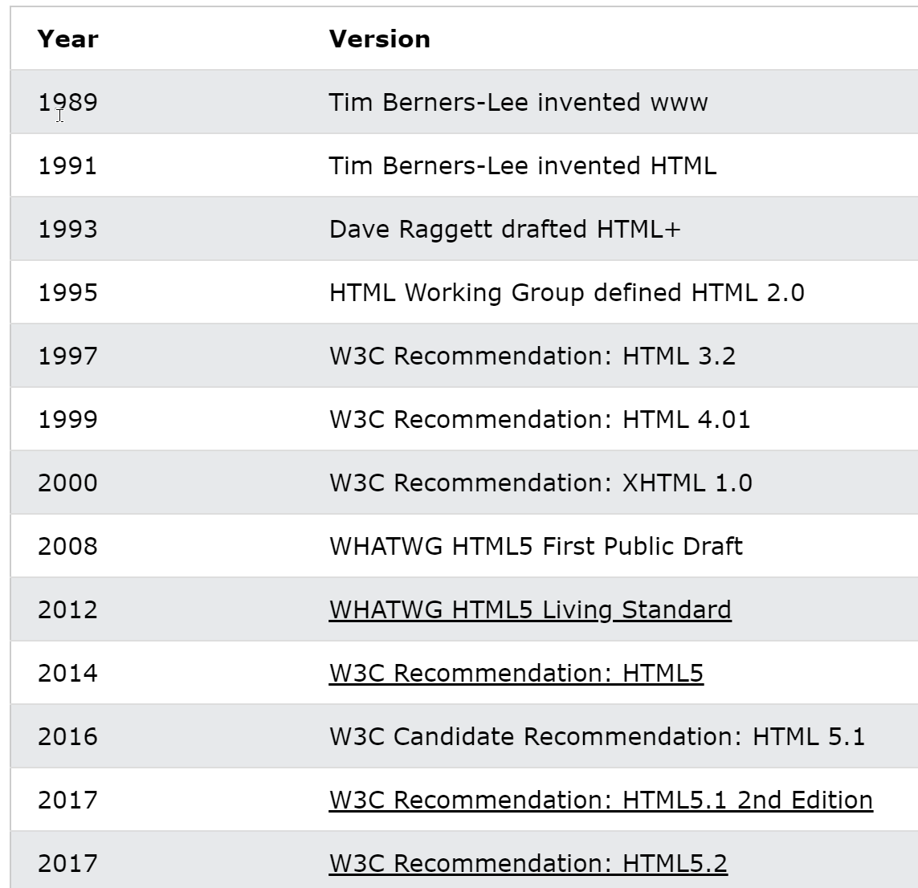
HTML history
Notes:
Here’s a short history of HTML. It was originally invented by Tim Berners Lee, the father of the WWW, and it has evolved across multiple versions to the latest update in 2014, which is HTML5. The World Wide Web Consortium (W3C) is responsible for the development of the HTML standard.

Slide 6
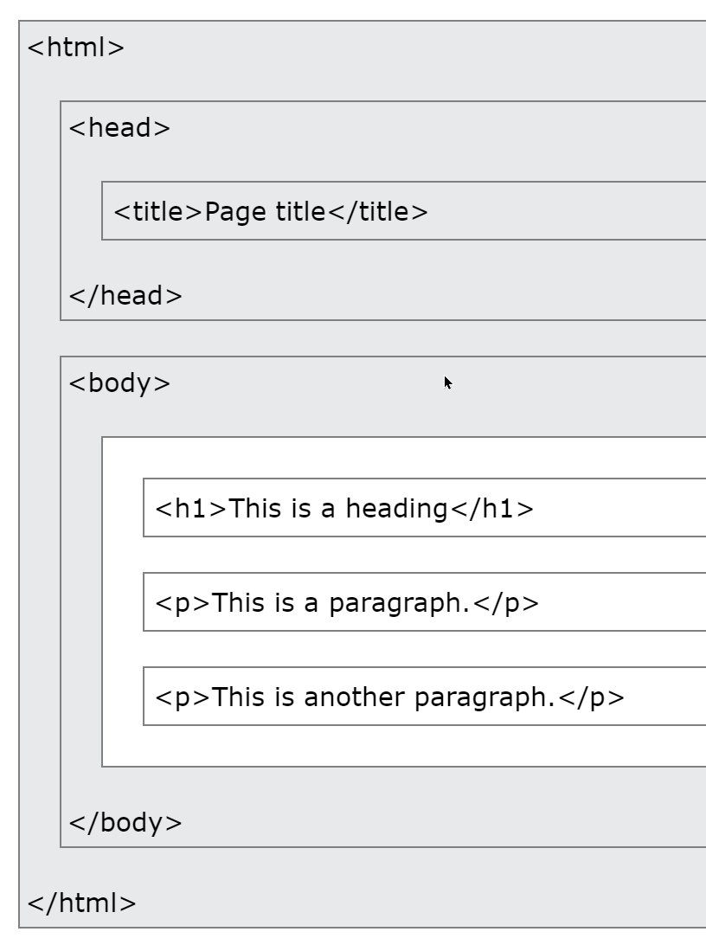
HTML page structure

Slide 7
Cascading Style Sheets
used for describing the presentation (layout and formatting) of the web pages
introduced to streamline the presentation of webpages
enables the separation of presentation and content
Standard maintained by W3C
Latest version is CSS3
Notes:
CSS stands for Cascading Style Sheets. CSS is a standard style sheet language used for describing the presentation (i.e. the layout and formatting) of the web pages.
Prior to CSS, nearly all of the presentational attributes of HTML documents were contained within the HTML markup (specifically inside the HTML tags). This mean that all the font colors, background styles, element alignments, borders and sizes had to be explicitly described within the HTML.
As a result, development of the large websites became a long and expensive process, since the style information needed to be replicated on every single page of the website.
To solve this problem CSS was introduced in 1996 by the W3C, which also maintains its standard along with HTML. CSS was introduced specifically to enable the separation of presentation and content.
With CSS, web designers can move the formatting information of the web pages to a separate style sheet which results in considerably simpler HTML markup, and better maintainability. CSS3 is the latest version of the CSS specification. CSS3 adds several new styling features and improvements to enhance the web presentation capabilities.

Slide 8
CSS functionality
apply same style rules on multiple elements within a single web page
control the presentation of multiple pages of a website with a single style sheet
present the same page differently on different devices

Slide 9
CSS functionality
change the position of an element on a web page without changing the markup
alter the display of existing HTML elements.
transform elements like scale, rotate, skew, etc. in 2D or 3D space.
create simple animations and transitions effects without using any JavaScript

